Slide 1
Milestone 1 Feedback

Slide 2
Overall
The blue bar at the bottom: if there is no purpose, should be removed
We do want to change the logo, but we are still designing it; we will send it once the design is done
For the inverted color, if not too difficult, we do want to see two different versions (one with white background and one inverted) so that we can decide which one to go with.
The most important question is can we fix some inputs through our backend system
We would love to have a meeting on Monday to clarify and discuss more

Slide 3
Specific pages

Slide 4
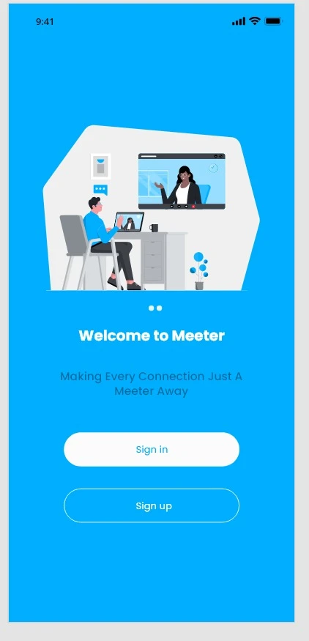
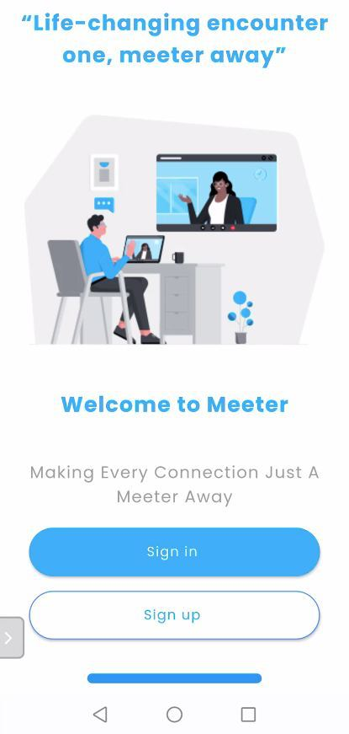
Page 1: Welcome Screen
Welcome screen
The “Life-changing encounter, one Meeter away” (comma at the wrong place and capitalize M)
The screen ratio adjustment for each page?
The screen is cut-off for some phones
Inverted color for this page
Different shades of blue for sign up button (can’t see it right now)
Can you increase the border thickness of the two buttons also?

Slide 5
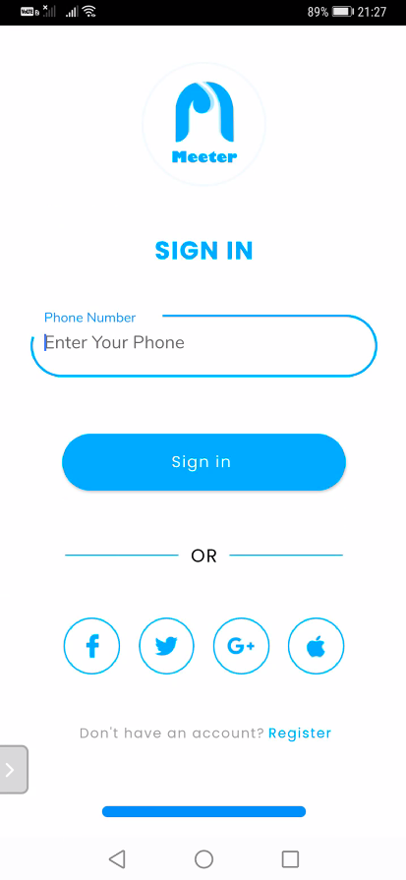
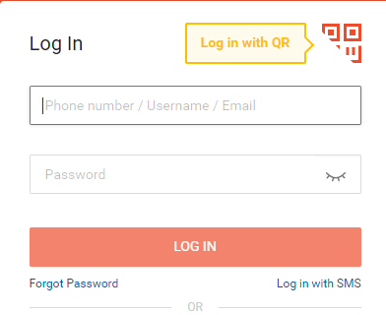
Page 2: Sign in screen
Sign in screen
The text at the blank should be “Enter your phone number” (case sensitive)
The textholder/text “Enter your phone number”, would it be possible to center the height in the textbox? (Apply to all textboxes)
Log in should be also possible through both email and phone number, not just phone number.
Not exactly this, but something like this

Slide 6
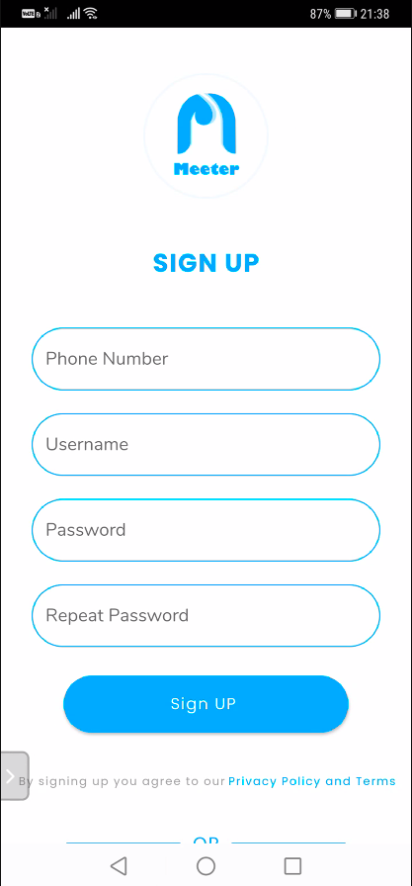
Page 3: Registration Page
Registration screen
As mentioned in page 3 feedback, sign up should require email address as well
“Sign UP” → “Sign Up”
#2

Slide 7
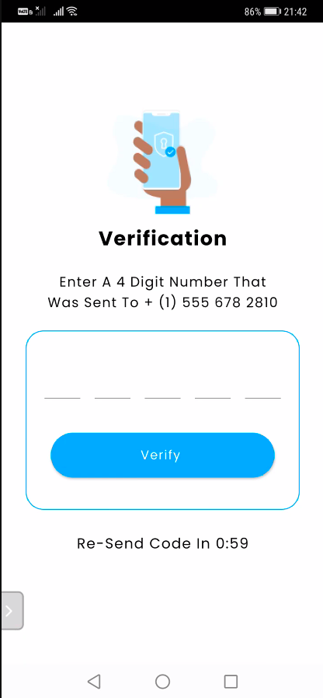
Page 4: Verification page
Verification screen
Do not capitalize all the word in the sentence. Only the first word would do: “Enter A 4 Digit Number That Was Sent To …”
→ “Enter the 4 digit number that was sent to
Why is there 5 number input and not 4? Change to 4 please!

Slide 8
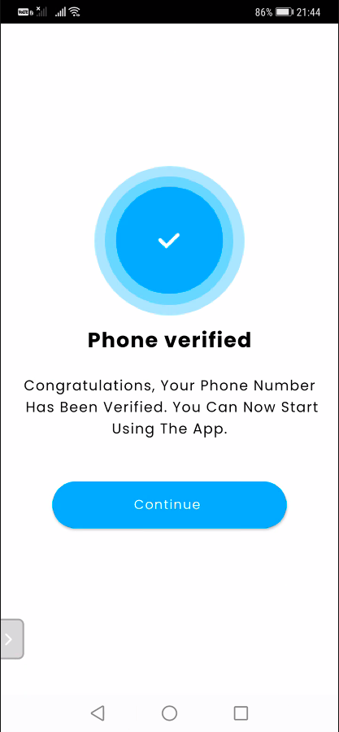
Page 5: Verified page
Verified screen
Same thing with capitalization:
Change the text to:
“Congratulations, your phone number have been verified. Welcome to Meeter!”

Slide 9
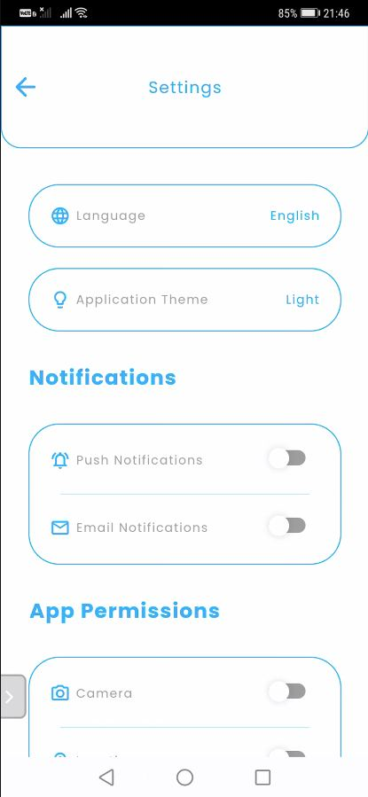
Page 6: Setting page
Setting screen
The title banner (at the very top) is too large, please reduce the height of the banner

Slide 10
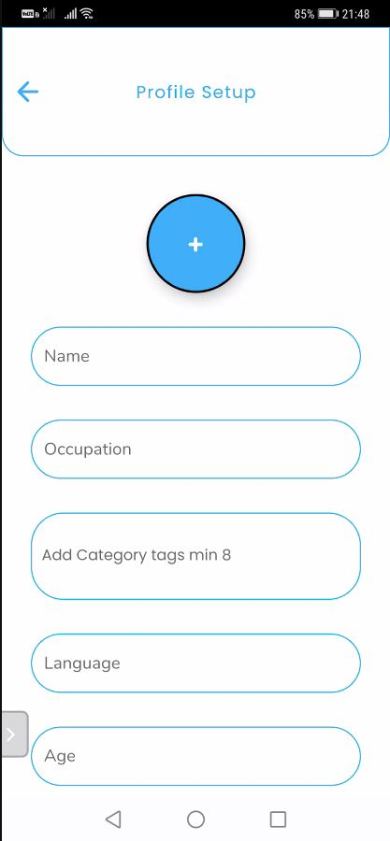
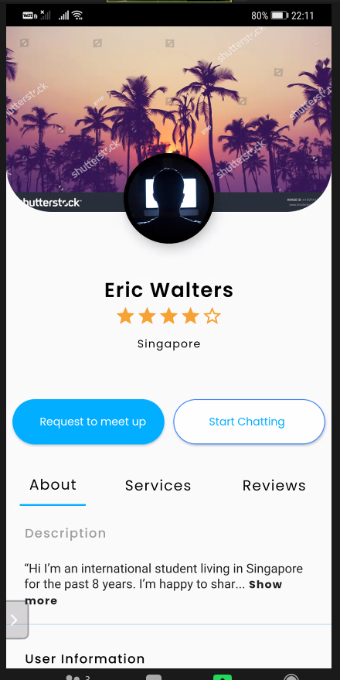
Page 7: Profile Setup page
Profile Setup screen
The title banner (at the very top) is too large, please reduce the height of the banner
Profile photo add button, can you use translucent/gradient without the black border line
Could you Change “Occupation” to “Bio”?
Could you remove the “Add Catergory tags min 8” text box? This is required for “seller profile setup”, not “initial profile setup”
Add “upload banner” icon/button in this same picture. The profile page has a banner picture as seen here

Slide 11
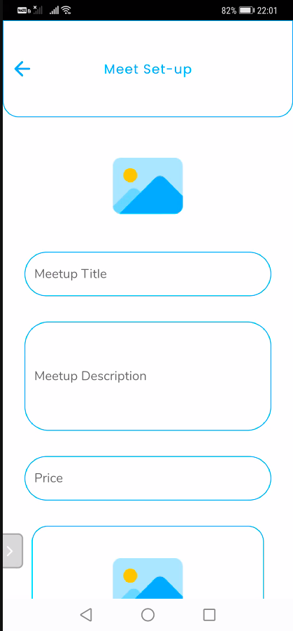
Page 8: Meet Setup page
Meet Setup screen
The title banner (at the very top) is too large, please reduce the height of the banner
Change “Meet Set-up” to “Meet Setup”
Change “picture” icon to “Upload a banner picture for your meet-up”
We need a tag input on this page so that people can filter the profiles when they search based on tags
Please remove this photo entry. We do not need a second photo here.

Slide 12
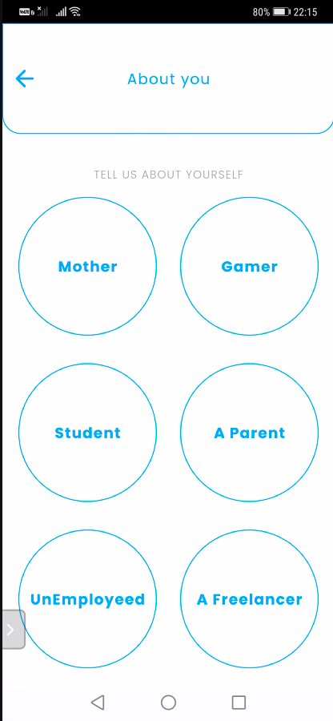
Page 9: About you
About you screen
The title banner (at the very top) is too large, please reduce the height of the banner
Change “About you” to “Click on all which applies to you!”
To clarify, in the future milestones, will there be an animation of the bubbles flowing and also the “pop” animation when these items are selected?
YES THE BUBBLES WILL POP
Change “Mother” to “Parent”
Change “A Parent” to “Entrepreneur”
Change “UnEmployed” to “ Job Seeker”
Change “Gamer” to “Scholar”
Change “A Freelancer” to “Freelancer”
Will we be able to add more bubbles / fix them through the back end system in the future?

Slide 13
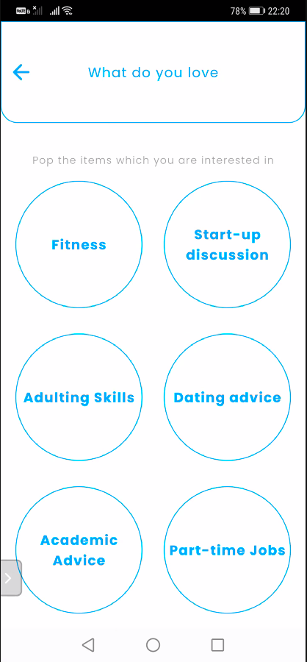
Page 10: What do you love
What do you love screen
The title banner (at the very top) is too large, please reduce the height of the banner
Change “What do you love” to “Select your interests!”
“Fitness” to “Fitness Lover”
“Start-up Discussion” to “Start-up”
“Adulting Skills” to “Life Skills”
“Dating advice” to “Dating”
“Academic Advice” to “Academic”
“Part-time Jobs” to “Employment”

Slide 14
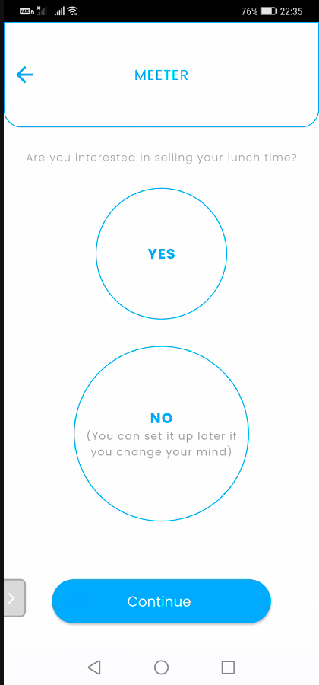
Page 11: “Selling” page
“Meeter” screen
The title banner (at the very top) is too large, please reduce the height of the banner
Change “MEETER” into “Setup a sellers listing?”
Please resize the “No” button to a smaller size than the “Yes” button

Slide 15
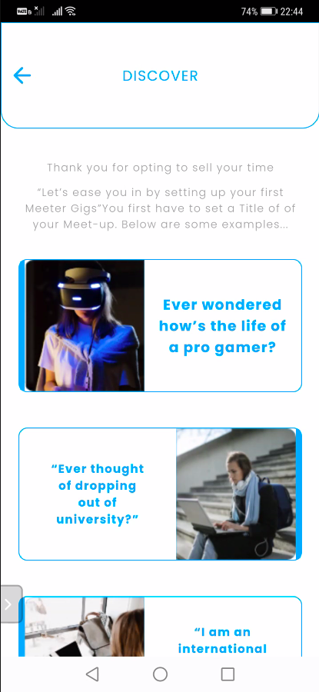
Page 12: Discover page (This should be part of set-up)
Meet Setup screen
The title banner (at the very top) is too large, please reduce the height of the banner
Change “Discover” into “Setting up a seller listing” This is actually not a “Discover” page but rather a page which is supposed to show after the user clicks “Yes” on page 11 screen where it shows examples of seller listing.
Grammar fixation for introduction text as below:
Thank you for opting to sell your time. Let’s ease you in by setting up your first Meeter listing. Let’s set a title first! Below are some examples…
Change the font color to more visible one
Standardize the font size of the listings

Slide 16
Page 12: Discover page
Discover screen
The title banner (at the very top) is too large, please reduce the height of the banner
Remove the subtexts “Thank you for…..” and “Let’s easy you in…”

Slide 17
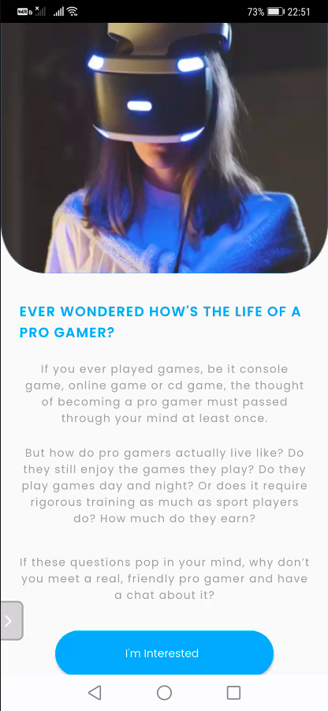
Page 13: Discover page 2
Discover page 2 screen
This is not supposed to appear in the setup page
The font color needs to be better...or the background color should be different (to make the text more visible)

Slide 18
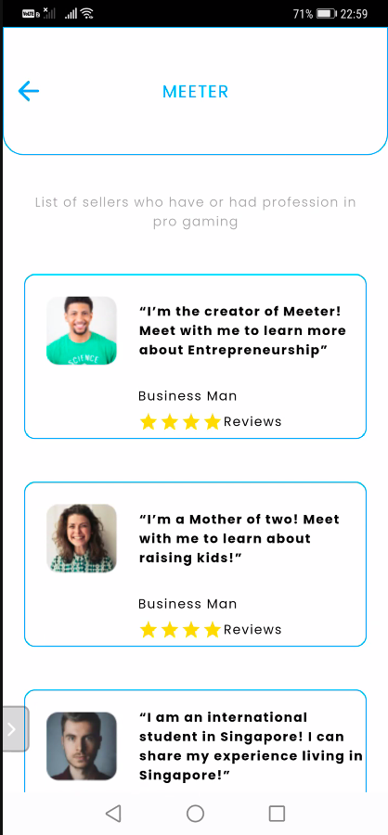
Page 14: Interested seller page (Discover page 3)
Interested seller page screen
The title banner (at the very top) is too large, please reduce the height of the banner
Possible to change the background color of the listing to a shade of blue?
Remove “The business Man” and maybe add a fake name instead
Reviews should be out of 5 and not 4
Also please change “☆☆☆☆ Reviews” to “Ratings ☆☆☆☆☆”
Also compress the texts a bit closer to each other

Slide 19
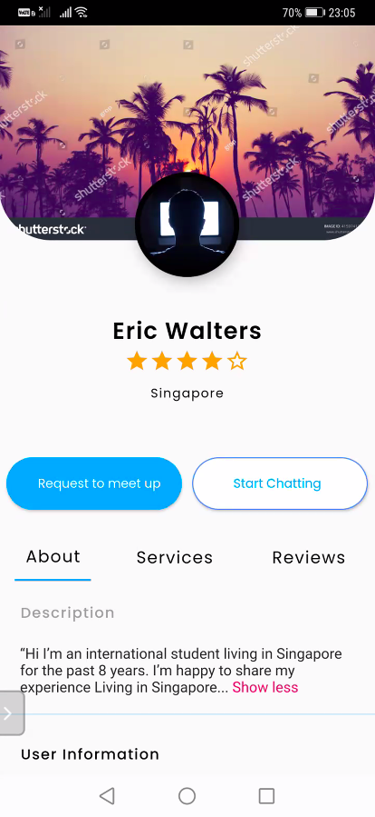
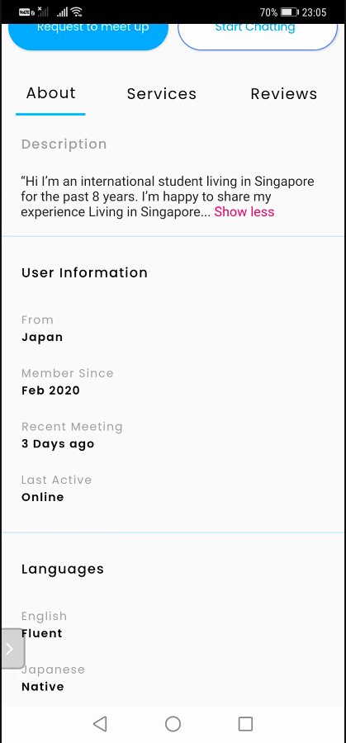
Page 15: Profile preview (upper)
Profile preview screen
Center the text “Request to meet-up” in the button
Remove “From Japan”

Slide 20
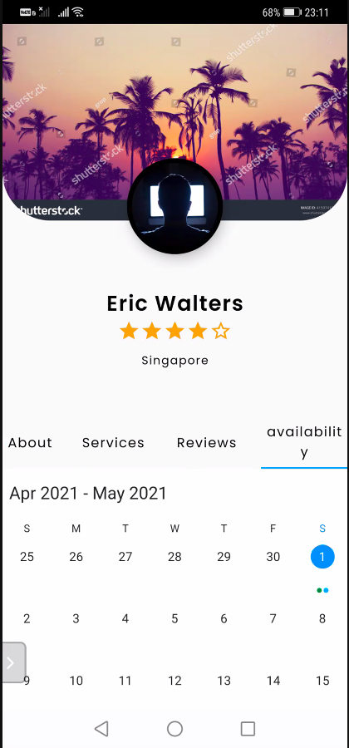
Page 16: Profile About
(when you see your own profile)
Profile About screen
Apply everything from “page 15: profile preview”

